Slide 1
Machine Learning I 60629A
Week #1

Slide 2
Today
Introduction to machine learning
The course (syllabus)
Math review (probability + linear algebra)

Slide 3
Machine Learning (ML)
Science that studies statistical and computational aspects of modeling data for predictive purposes
(Mostly) Empirical science

Slide 4
Data
ML
Predictions
Task: Predict whether an image contains a malignant tumor
Task: Predict the next movie a person should watch

Slide 5

Laurent Charlin — 60629
https://xkcd.com/1838/

Slide 6
“Data analysis, machine learning and data mining are various names given to the practice of statistical inference, depending on the context.”
Probability
Data generating process
Observed data
Inference
–Larry Wasserman in “All of Statistics: A Concise Course in Statistical Inference.”

Slide 7
What is the goal of ML?

Slide 8
A bit of historical context
When I started my PhD very few in ML talked about AI
Recent ML makes progress toward “AI tasks”
Examples of AI tasks: translation, object recognition
In that context: create a machine with human-like capacities? Or a machine that can help humans?

Slide 9
My (imperfect) view:
Understand data through predictive models Understand the world through predictive models

Slide 10
How does ML relate to other fields

Slide 11
Historical View
(Modern) Statistics: ~1900
Machine Learning and Data Mining: ~1960
Data Science: ~2000
11

Slide 12
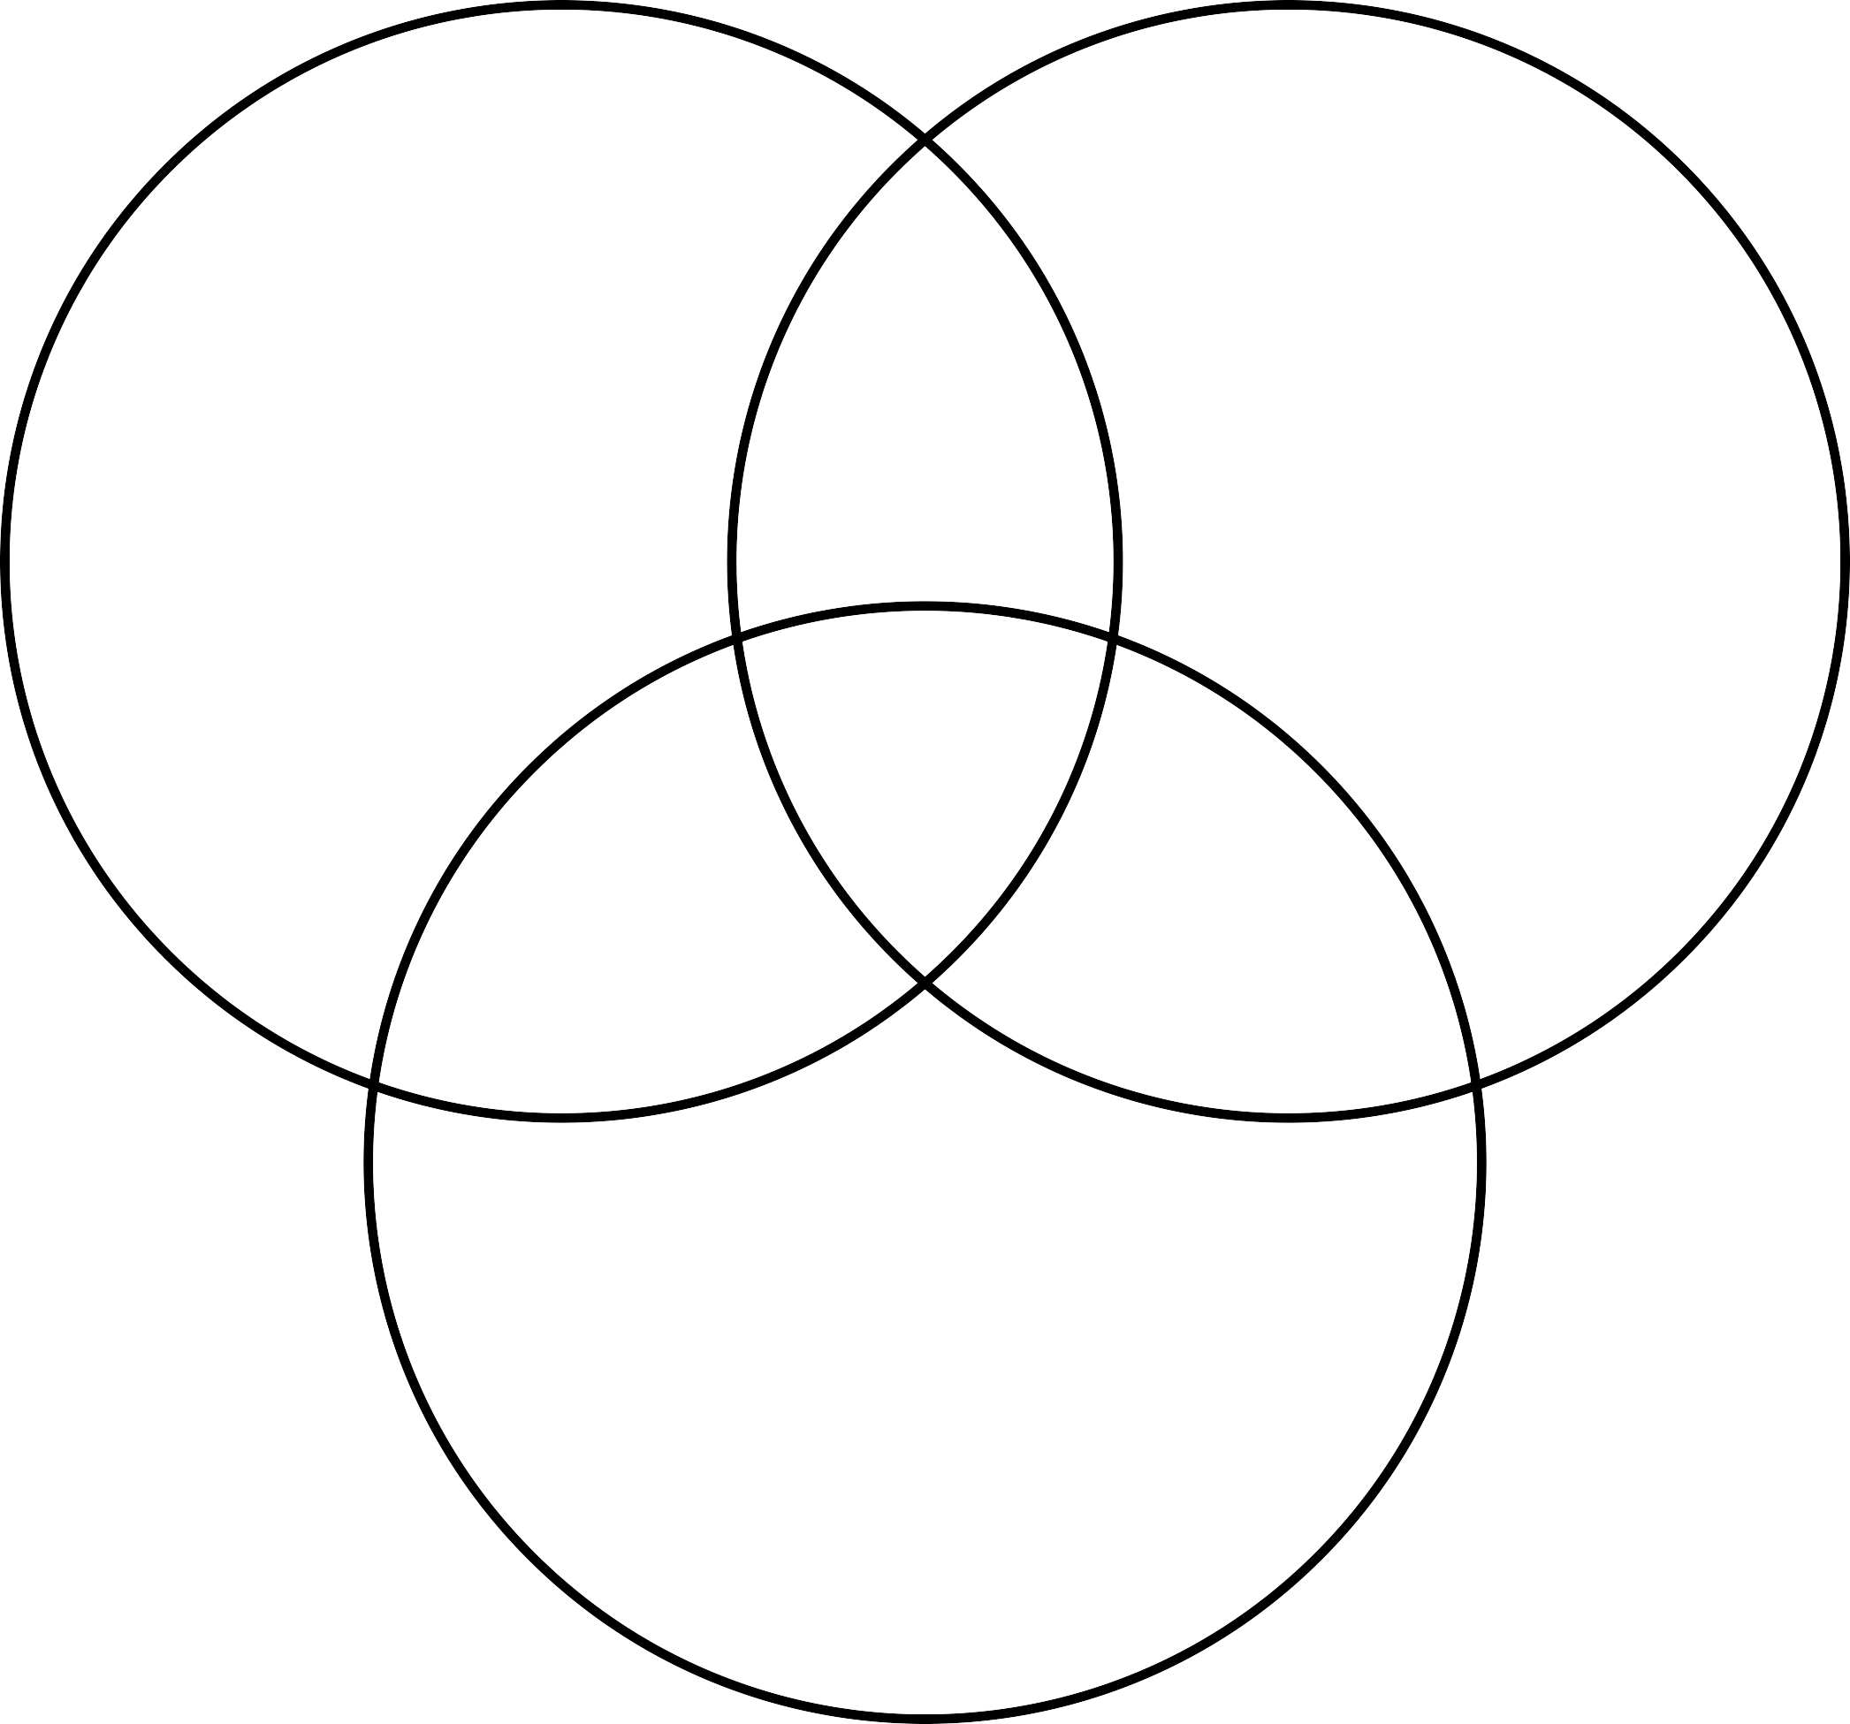
Computer Science
+
Engineering
Machine Learning
Statistics
+
Mathematics
Data Science (BI)
Danger Zone
Traditional Research
Substantive Expertise
12
[Inspired by Drew Conway]

Slide 13
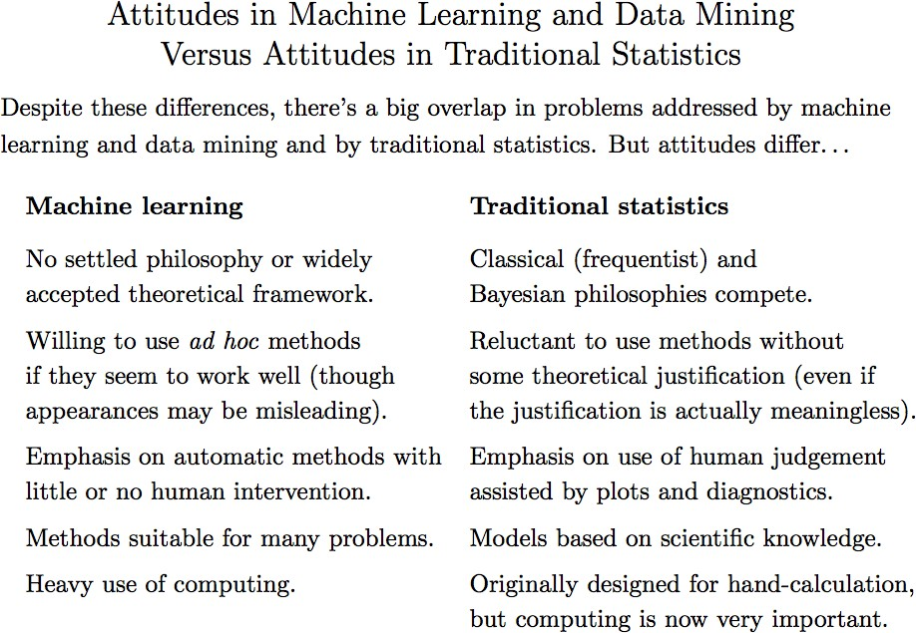
Laurent Charlin — 60629
[Reproduced from R. Neal: http://www.utstat.utoronto.ca/~radford/sta414.S14/week1.pdf ]

Slide 14

Artificial Intelligence
Machine Learning
Deep Learning

Slide 15
Applications of ML
15

Slide 16
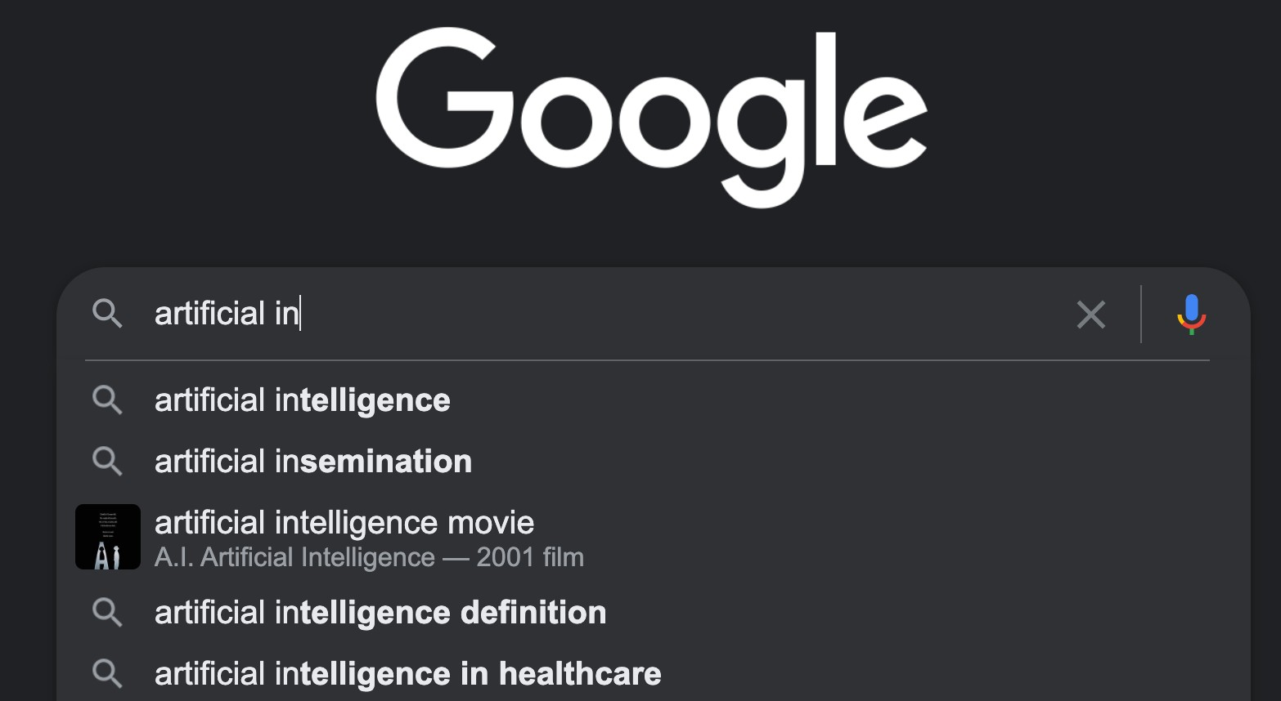

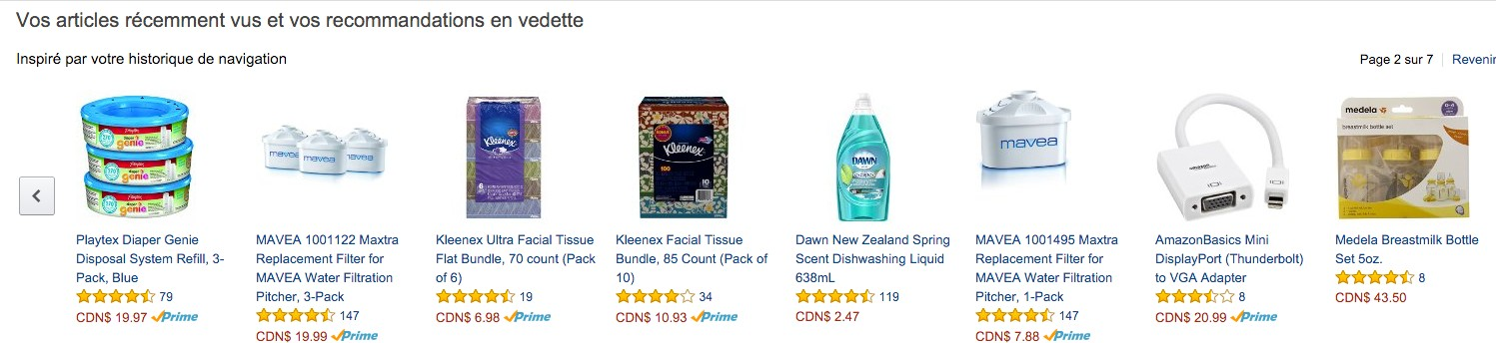

Slide 17
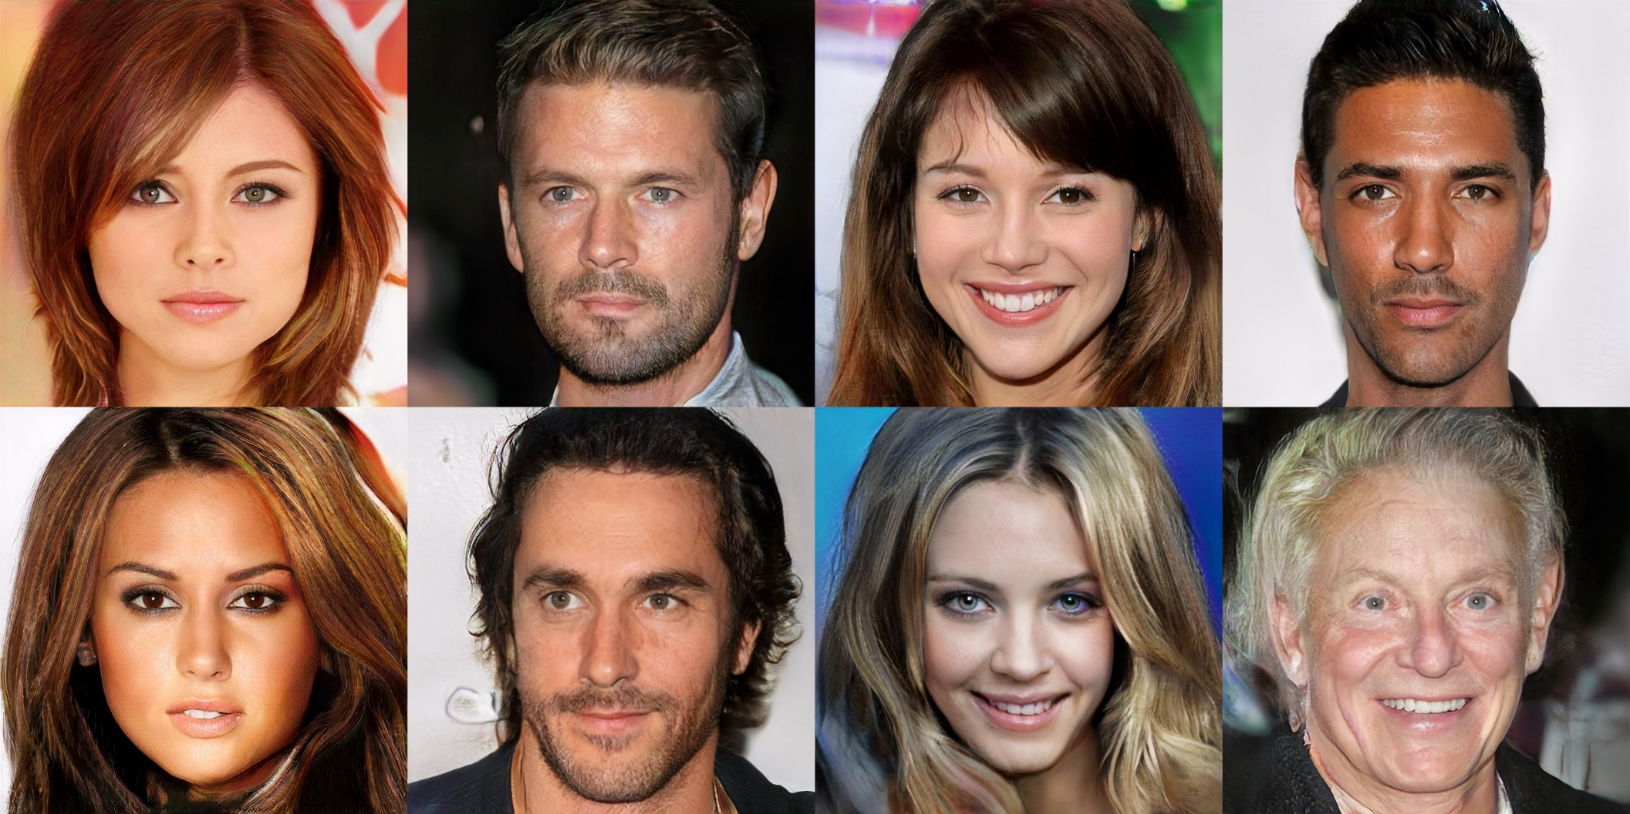

Progressive Growing of GANs for Improved Quality, Stability, and Variation
Karras et al., ICLR’18

Slide 18

All computer generated
Progressive Growing of GANs for Improved Quality, Stability, and Variation
Karras et al., ICLR’18

Slide 19
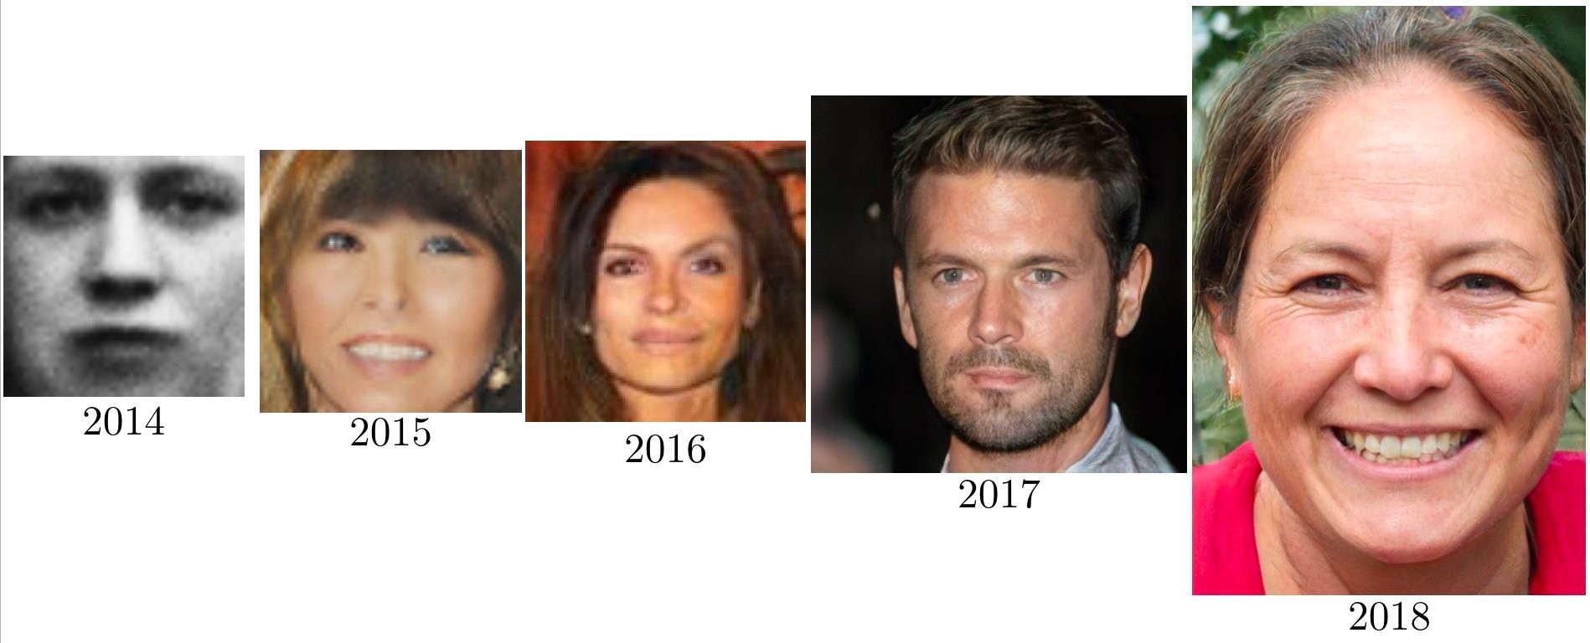
Laurent Charlin — 60629
https://twitter.com/goodfellow_ian/status/1084973596236144640/photo/1

Slide 20
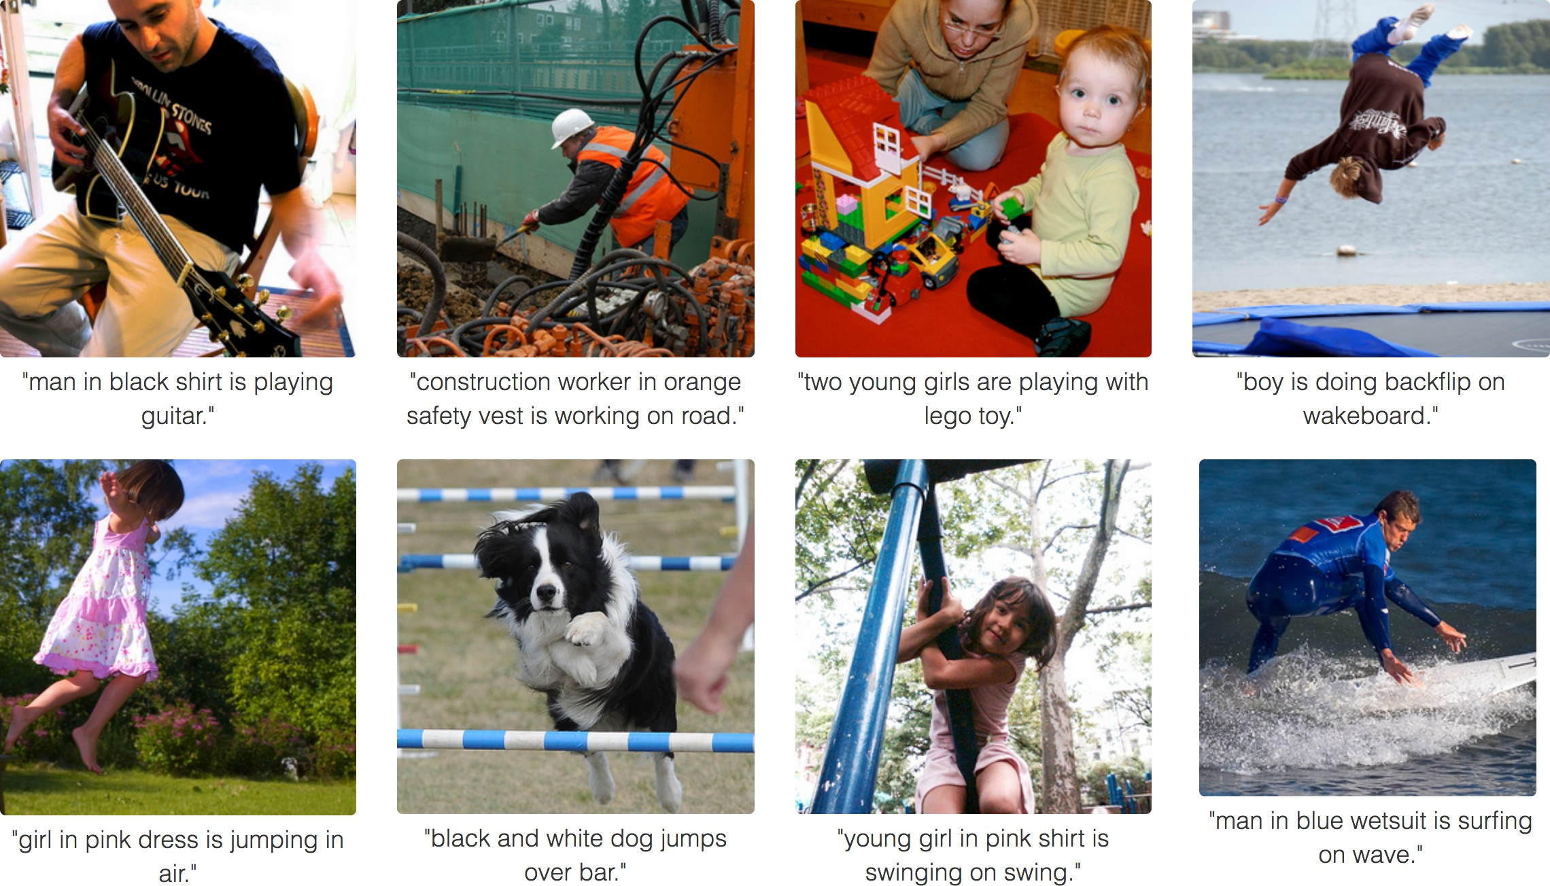
Deep Visual-Semantic Alignments for Generating Image Descriptions
A. Karpathy, L. Fei-Fei, CVPR’15

Slide 21
Deep Visual-Semantic Alignments for Generating Image Descriptions
A. Karpathy, L. Fei-Fei, CVPR’15

Slide 22




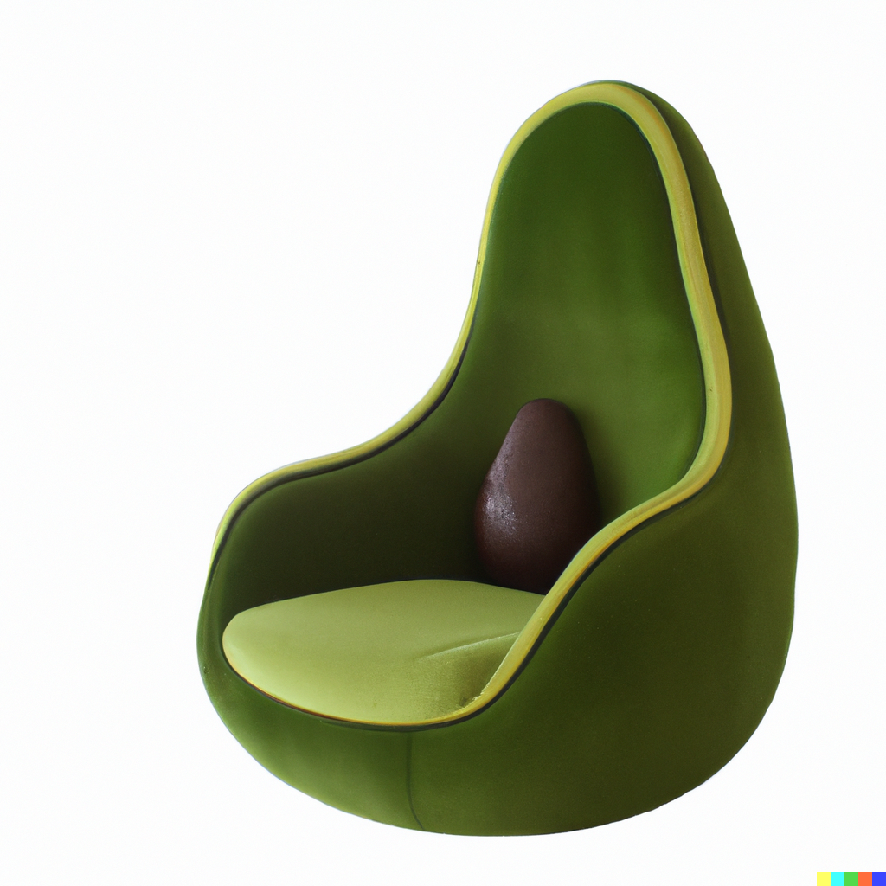




Dall-e 2
Stable Diffusion 1.5
https://huggingface.co/spaces/runwayml/stable-diffusion-v1-5
https://openai.com/blog/dall-e/

Slide 23

Generate an image from a text prompt
A bowl of soup that looks like a monster spray-painted on the wall
https://openai.com/dall-e-2/

Slide 24


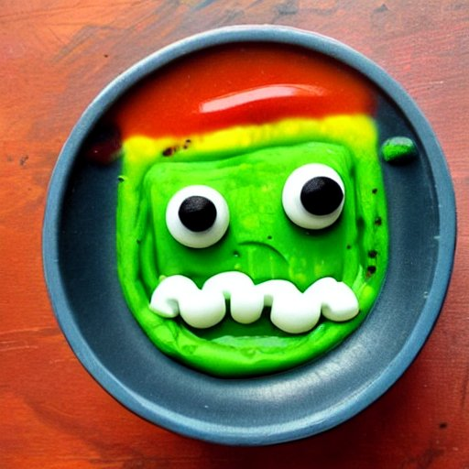

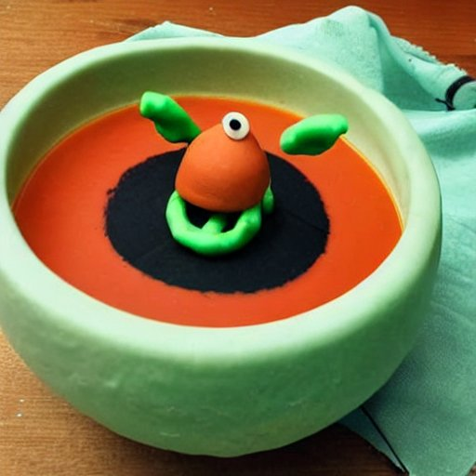
Generate an image from a text prompt
A bowl of soup that looks like a monster made out of plasticine
Stable Diffusion 1.5
https://openai.com/dall-e-2/

Slide 25



Generate an image from a text prompt
Two women shaking hands
https://openai.com/dall-e-2/

Slide 26



Stable Diffusion 1.5
https://openai.com/dall-e-2/

Slide 27
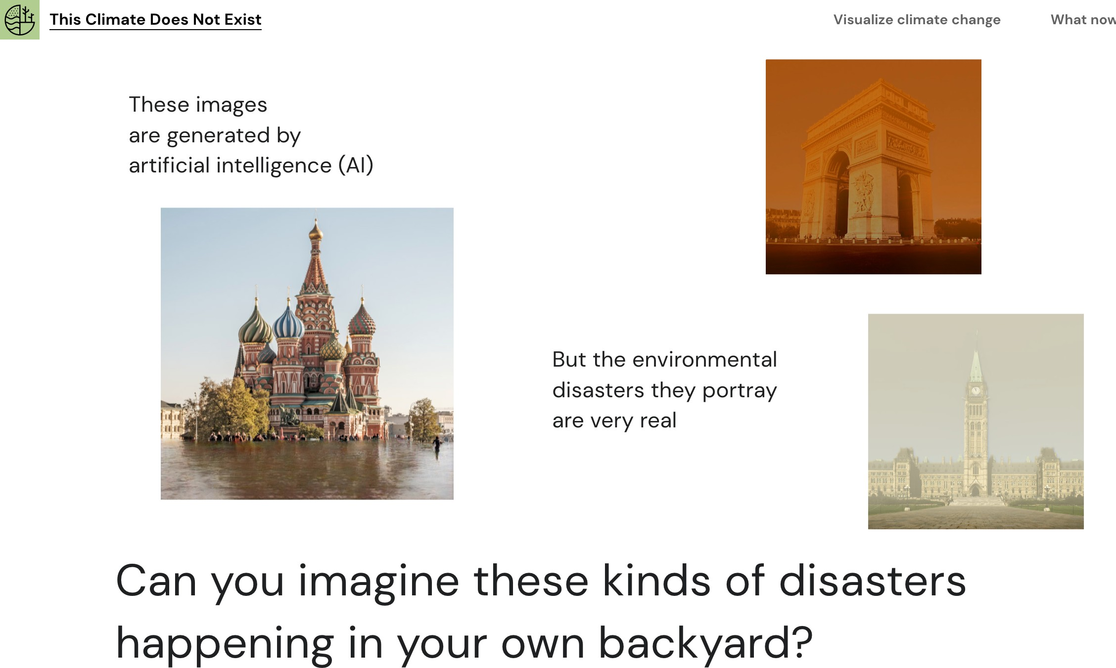
Laurent Charlin — 60629

Slide 28

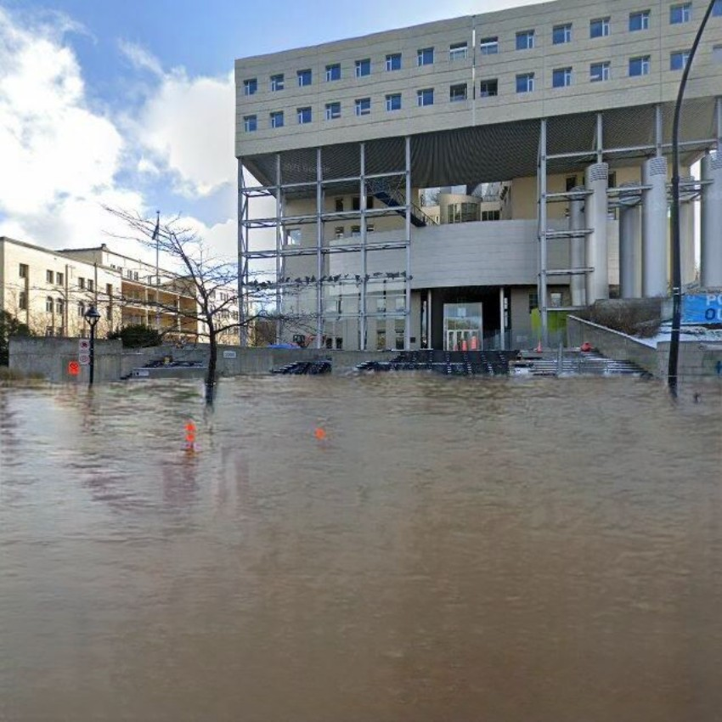
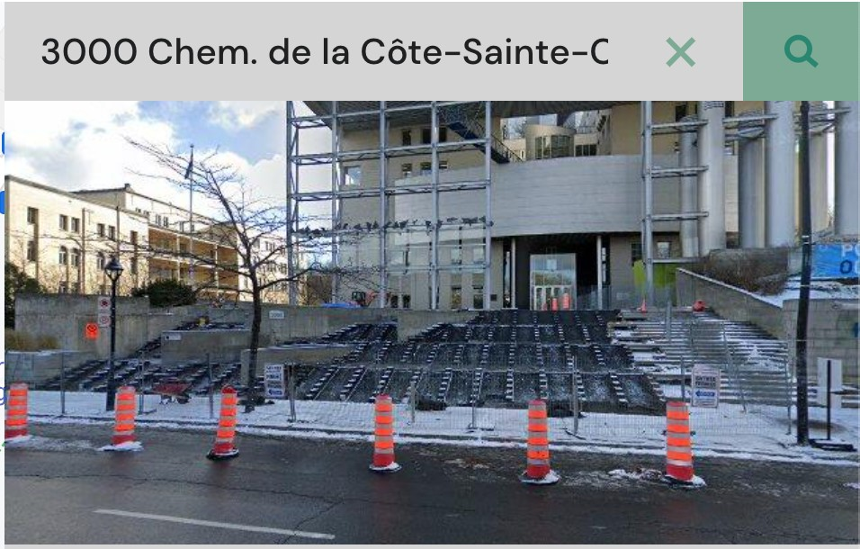
Laurent Charlin — 60629
https://thisclimatedoesnotexist.com/en/share/57d2b713-a6ea-474b-8d32-2012db0f050b

Slide 29
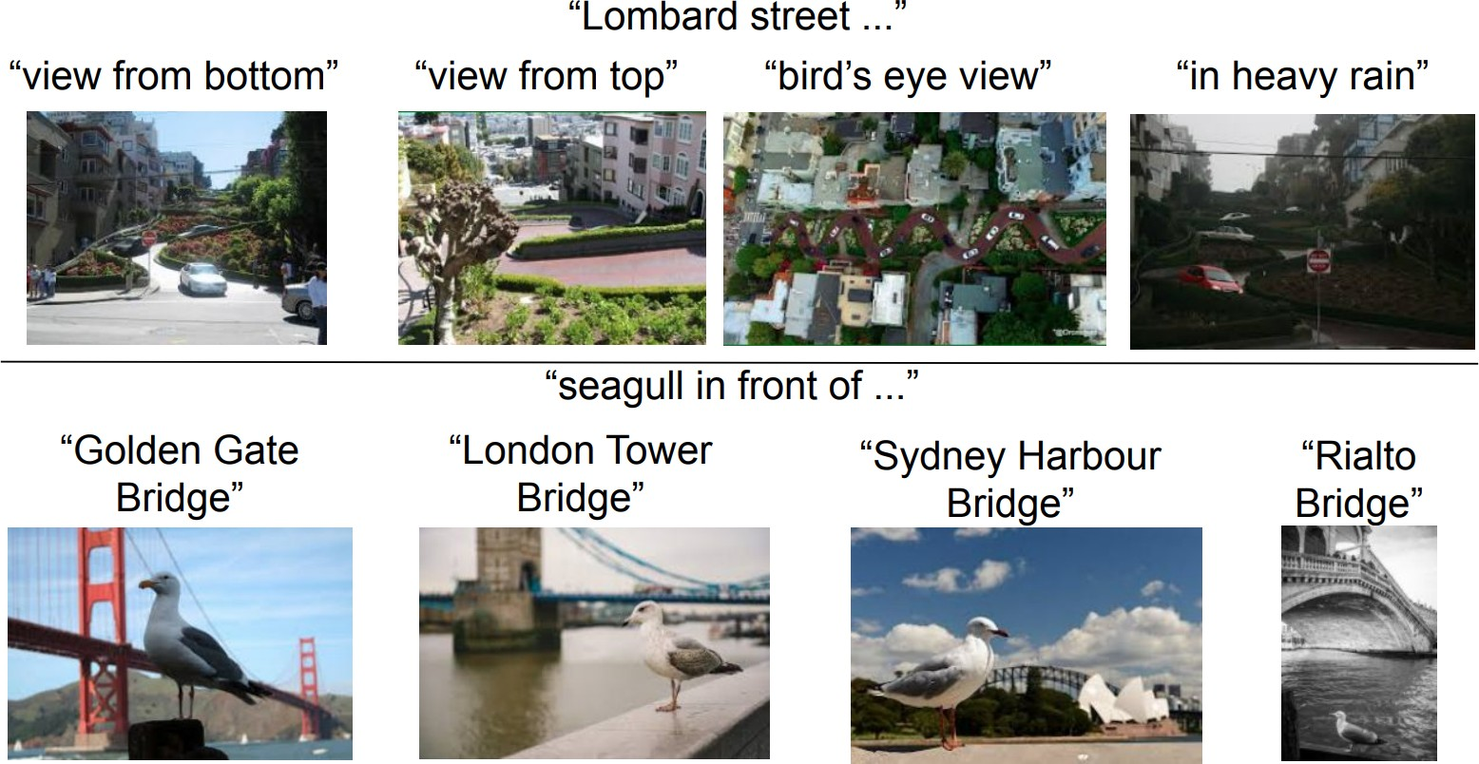
[Jia et al. 21, CoRR: 2102.05918]

Slide 30
[Jia et al. 21, CoRR: 2102.05918]

Slide 31
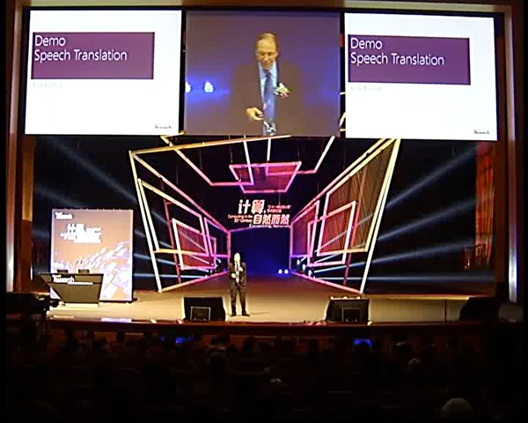

Slide 33
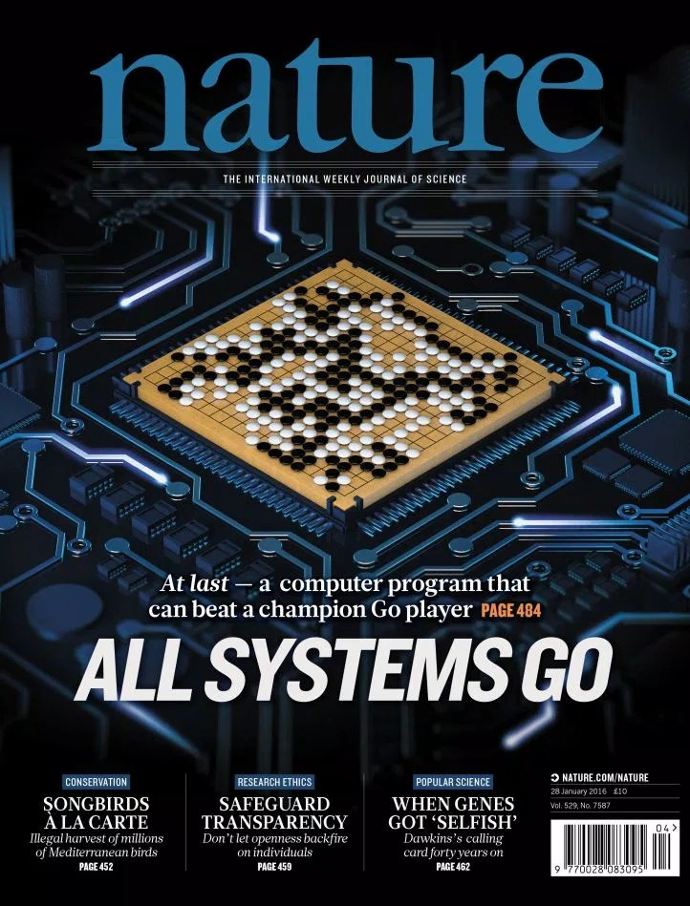
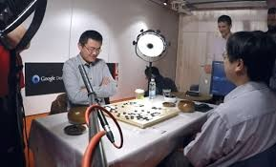

Slide 34
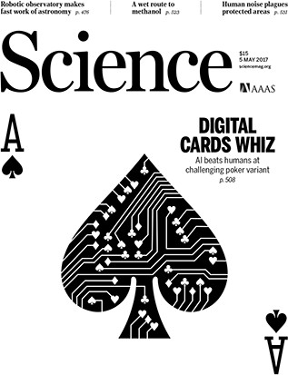

Slide 35

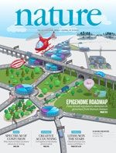
AI for video games
Mnih et al. Nature Volume 518,
pages 529–533
(26 February 2015)

Slide 36


Slide 38
Medicine: personalized, automate diagnostics
Social sciences: prediction problem (e.g., predict recidivism)
Engineering: to propose new design, evaluate without building
Finance: capture uncertainty, short-term trading
Marketing: to understand and quantify user experience, advertising efficacy
Many others: conservation, social projects, climate change
Your domain of expertise…
31

Slide 39
Course Introduction & Goals

Slide 40
Logistics
Course syllabus: http://www.cs.toronto.edu/~lcharlin/courses/60629/

Slide 41
Flipped Classroom
Every week:
Class preparation (Offline):
Weekly material (~90 minutes)
Reading, watching capsules
Class time (Online):
Summary, Q&A, problem solving (120 minutes)

Slide 42
Suggestions for navigating a flipped classroom
In class: Come prepared
Watch the capsules ahead of time
Do the readings
Write down your questions
Capsules: Stay active while watching the capsules (e.g., take notes, pause, go back, think of how it fits in the broader context)

Slide 43
Fit with other courses
HEC
PhD level (originally)
Computationally oriented
Prequel to
Machine Learning II: Deep Learning (MATH 60630A)
Trustworthy Machine Learning (MATH 80630)
Other ML courses in Montreal (U.Montreal, Polytechnique, Mcgill)
More applied (similar to COMP-551@McGill)

Slide 44
Short review of linear algebra, statistics,
and probabilities

Slide 45
Based on chapters 2 and 3 of “Deep Learning”
http://www.deeplearningbook.org/

Slide 46
Linear algebra
Scalar: a single value.
a E R, a E N
Vector: an array of values.
a R , a N
Matrix: a table of values.
a = 3
₃
D
D
 
a =
4
2
l
3 4 2
1 2 9
A E R^{D1 xD2} , A E N^{D1 xD2}
A =

Slide 47
Indexing notation
Indexing elements of a vector:
a_{i}
Convention:
The first element is the zero’th.
₃
 
a₁
a = 4
2
Indexing elements of a matrix: aij
l
3 4 2
1 2 9
A =
a12

Slide 48
Simple operations
Transpose
a
0
a =
a₁
a₂
a^{T} = a₀ a₁ a₂
(A_{ij})^{T} = A_{ji}
Addition
Vectors and matrices w. the same shape
b
a + b
0
0 0
b = b
a + b = a + b
(A + B)
= A + B
1
1 1
ij
ij
ij
b
a₂ + b₂
2

Slide 49
Simple operations
f
Multiply by a scalar
a a
0
aa =
a a₁
a a₂
Vector product.
The dot product
Note: it yields a scalar.
Element-wise product:
a^{T}a =
_{i} a_{i}a_{i}
I
a a
0 0
a 0 a =
a₁a₁
Also known as Hadamard product
a₂a₂

Slide 50
Operations
Matrix product (dot product):
C_{ij} =
k ^{A}ik^{B}kj
A's columns must equal B’s rows (order is important)
A E R^{D1 xD2} , B E R^{D2 xD3}
Distributive:
Associative:
A(B + C) = AB + AC
A(BC) = (AB)C
Product of transpose: (AB)^{T} = B^{T}A^{T}

Slide 51
Inverse
We denote a matrix’s inverse as
A matrix has an inverse iff:
_{A}-1
it’s square.
D₁ = D₂
A square matrix
not invertible is singular
its columns are linearly independent.
No column can be recovered using a combination of other columns
Inverses are useful to solve systems of equations:
Ax = b x = A⁻¹b

Slide 52
Norms
L^{p}norm. Size of a vector (or matrix)
1/p
I a I_{p}=
Standard norms in ML:
Euclidean norm (p=2)
|a_{i}|
p
i
I a I₂= ^{1�I(�} |a_{i}|²
i
Dot product w. 2-norm:
a^{T}b = ||a||₂||b||₂ cos θ_{ab}
1
{
\
Frobenius norm (matrix):
1
\
L L
}
\ A \ =
|a |
2
2
ij
i j

Slide 53
Special matrices & vectors
1 0 0
I₃ = 0 1 0
0 0 1
Identity. Denoted ^{I}n.
•
All zeros except for ones on the main diagonal.
Symmetric:
Unit vector:
A = A^{T}
a/1₂ = 1
Orthogonal vectors: a^{T}b = 0
Orthonormal vectors: unit and orthogonal
A^{T}A = AA^{T} = I
Orthogonal matrix: Orthonormal rows & columns

Slide 54
Skip eigendecomposition, SVD, pseudo-Inverse, determinants (Sections 2.7–2.11).
We will get back to them if/when needed in the course.

Slide 55
On to probabilities
Chapter 3 of “Deep Learning”
I’ve adapted some of the lecture slides from the book.
Thanks to Ian Goodfellow for providing slides.

Slide 56
Why probabilities?
To capture uncertainty
E.g., What time will I get home tonight?
Probabilities provide a formalism for making statements about “data generating processes” (L. Wasserman)
E.g., what happens when I flip a fair coin?
Probability
Data generating process
Observed data
Inference

Slide 57
The example
Generate data by throwing a fair die.
What do we know about a single throw?
6 possible outcomes. (sample space)
Each outcome (e.g., 1). (element, state)
A subset of outcomes (e.g., <3). (event)
Outcomes are equiprobable. (uniform distribution)

Slide 58
Random variables and probabilities
A random variable (r.v.) is a probabilistic outcome.
For example,
Die throw (X)
The actual outcome is E {1, 2, 3, 4, 5, 6}. (x)
A probability function (P) assigns a real number to each possible event: P(x) 2 0, Vx E X
P x = 1

Slide 59
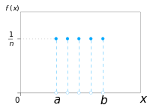
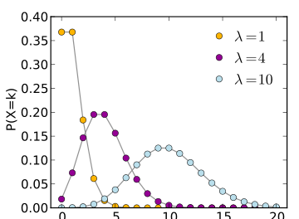
Discrete RVs
An RV is discrete if it takes a finite number of values¹
P(x = x_{i}) � 0, \ii
P(x = x_{i})
P(x = x_{i}) = 1
1
k
i
E.g., uniform distribution:
1
P(x = x ) =
, Vi
i
k
E.g., Poisson distribution:
P(x = x_{i}; ,\) =
,\^{xi} exp^{-,\}
x_{i}!
1. technically: it must be countable
both images are
from: wikipedia.org
Laurent Charlin — 60629
52

Slide 60
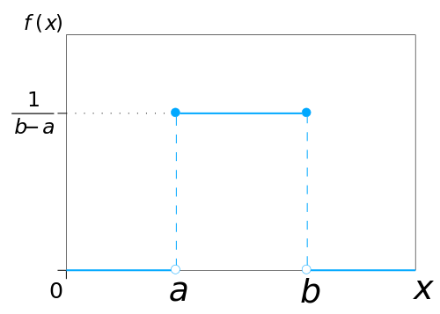
Continuous RVs
An RV is continuous if f(x) � 0, Vx E X
r
oo
f(x)dx = 1
-oo
P(a < x < b) = f(x)dx
r
b
a
f(x) is a probability density function (PDF)
E.g., (continuous) uniform distribution:
(
if x 2 [a, b]
0 otherwise
1
u(x; a, b) =
b-a
E.g., Gaussian distribution
from: wikipedia.org

Slide 61
A few useful properties
(shown for discrete variables for simplicity)
Sum rule:
Product rule:
n
Chain rule: P(X_{l}, . . . , X_{n}) = ^{rr} P(X_{i} | X_{l}, . . . , X_{i−l})P(X_{l})
i=l
If x and y are independent:
Bayes’ Rule:

Slide 62
Moments
Expectation:
Variance:
Covariance:
L
E[X] = P(x = x )x
E[aX] = aE[X]
i i
i
o-² = E[(X - E[X])²]
Cov(X, Y) = E (X - E[X])(Y - E[Y])
Cov(X, Y)
correlation: p(x, y) =
<J_{x}<J_{y}

Slide 63
Further Reading
Prologue to “The Master Algorithm”
http://homes.cs.washington.edu/~pedrod/Prologue.pdf
Ch. 1 of Hastie et al.
Math Preparation
Ch.2 of Pattern Recognition and Machine Learning [PRML]
Ch.2-3 of Deep Learning [DL]
Slightly more advanced:
http://www.cs.mcgill.ca/~dprecup/courses/ML/Materials/prob-review.pdf http://www.cs.mcgill.ca/~dprecup/courses/ML/Materials/linalg-review.pdf

